Slide 1
Camp OFLA 2021
June 6-12, 2021: Arabic, Chinese, Russian
www.campofla.org
Sponsored by the Ohio Foreign Language and Startalk

Slide 3
Purpose
Of
Camp OFLA
To provide an opportunity for elementary students in Ohio to explore and acquire another language
and culture

Slide 4
Camp Structure/Participants
per year
Campers: 75
Counselors: 6-12
Teachers: 3
University Assistants: 3
Staff: 6-8

Slide 5
Languages
Arabic
Chinese
Russian

Slide 6
Typical Day
7:55 Flag Raising
8:00 Breakfast
9:15 Language Lesson
10:00 Craft / Cooking / Song & Dance
10:45 Language Lesson
12:00 Lunch & Rest
13:30 Language Lesson
14:30 Swim
15:45 Language Lesson
16:45 Hike /Song & Dance / Crafts
17:30 Dinner
18:30 Cultural Sharing Time
19:30 Evening Activity
20:45 Snack Time
21:15 Return to Cabins
22:00 Lights Out

Slide 7
Cooking
morning cooking class
evening snack for all campers
different culture each day

Slide 8
Music

Slide 9
Crafts

Slide 10
Crafts

Slide 11
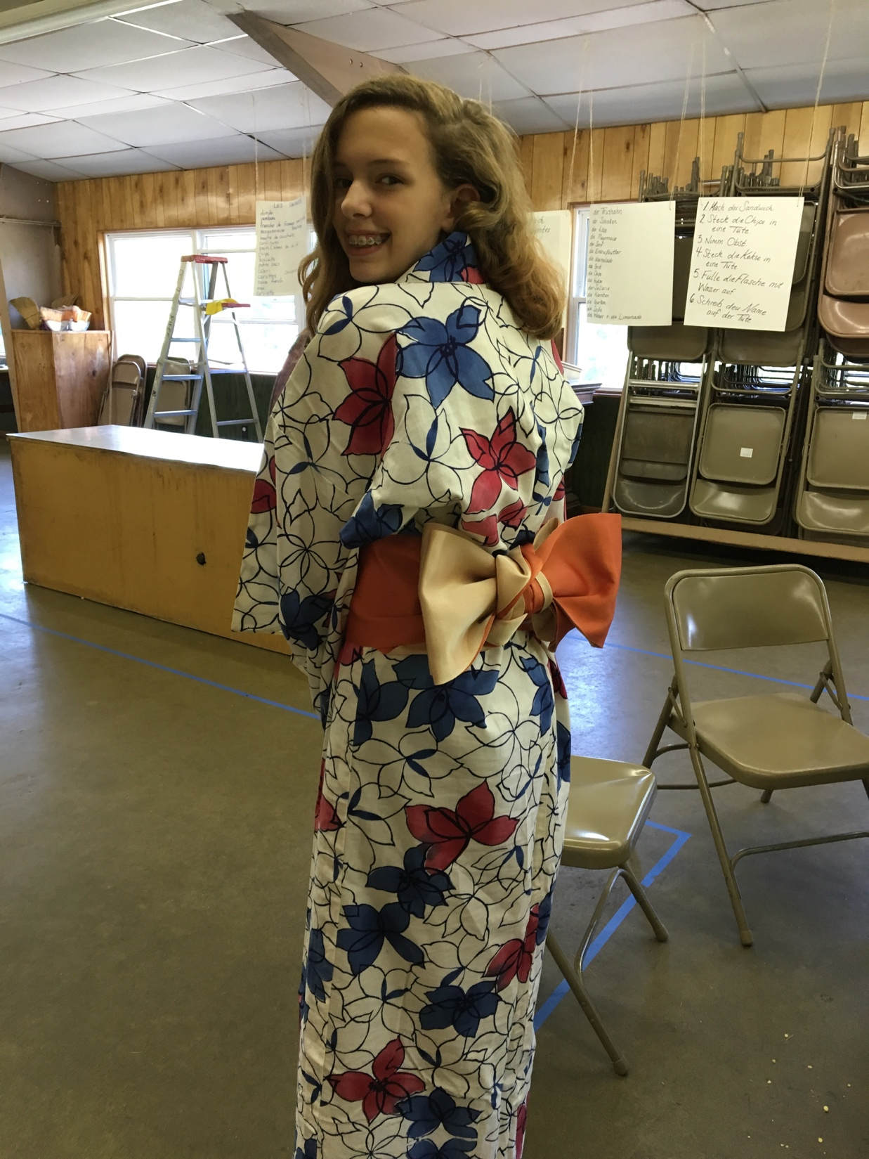
Cultural sharing

Slide 12
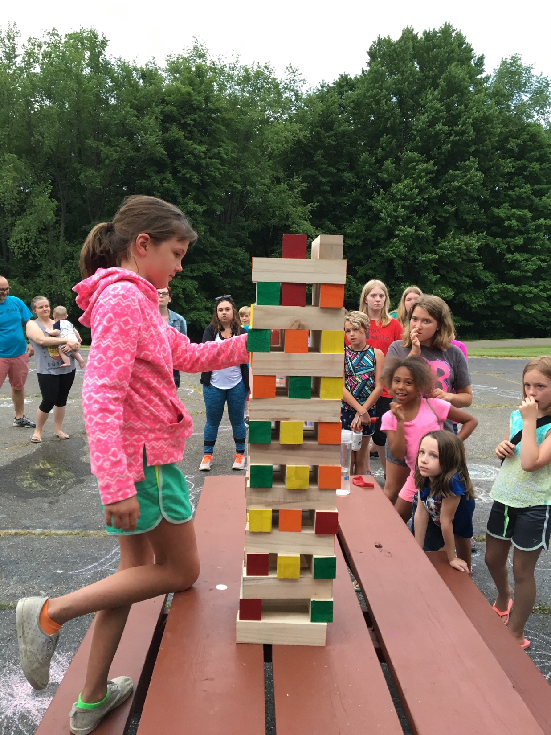
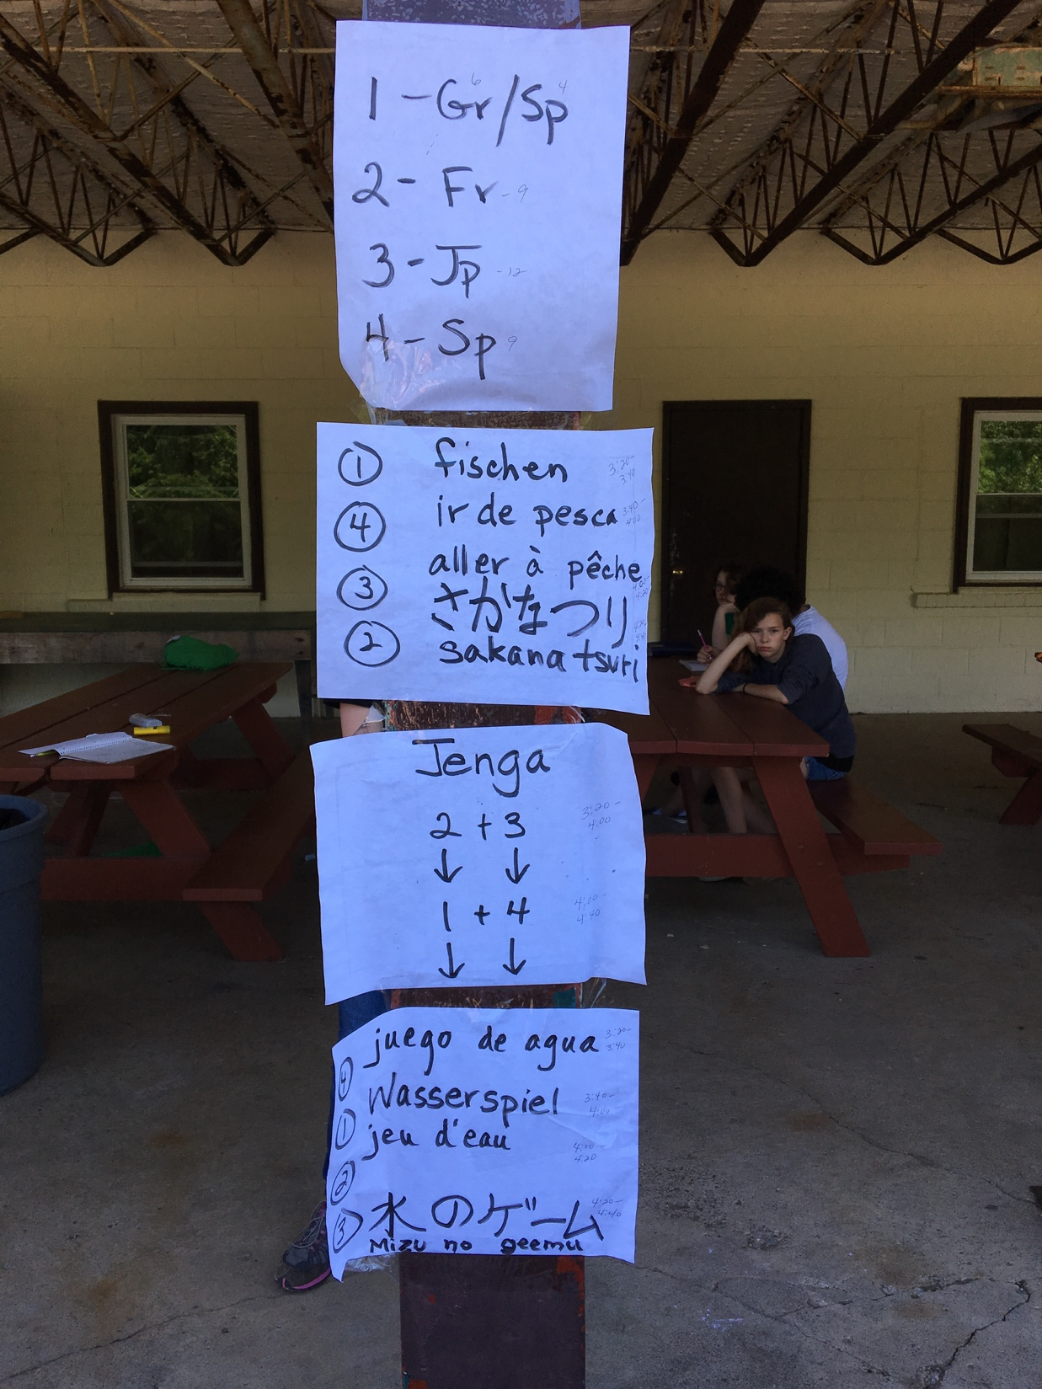
Games

Slide 13
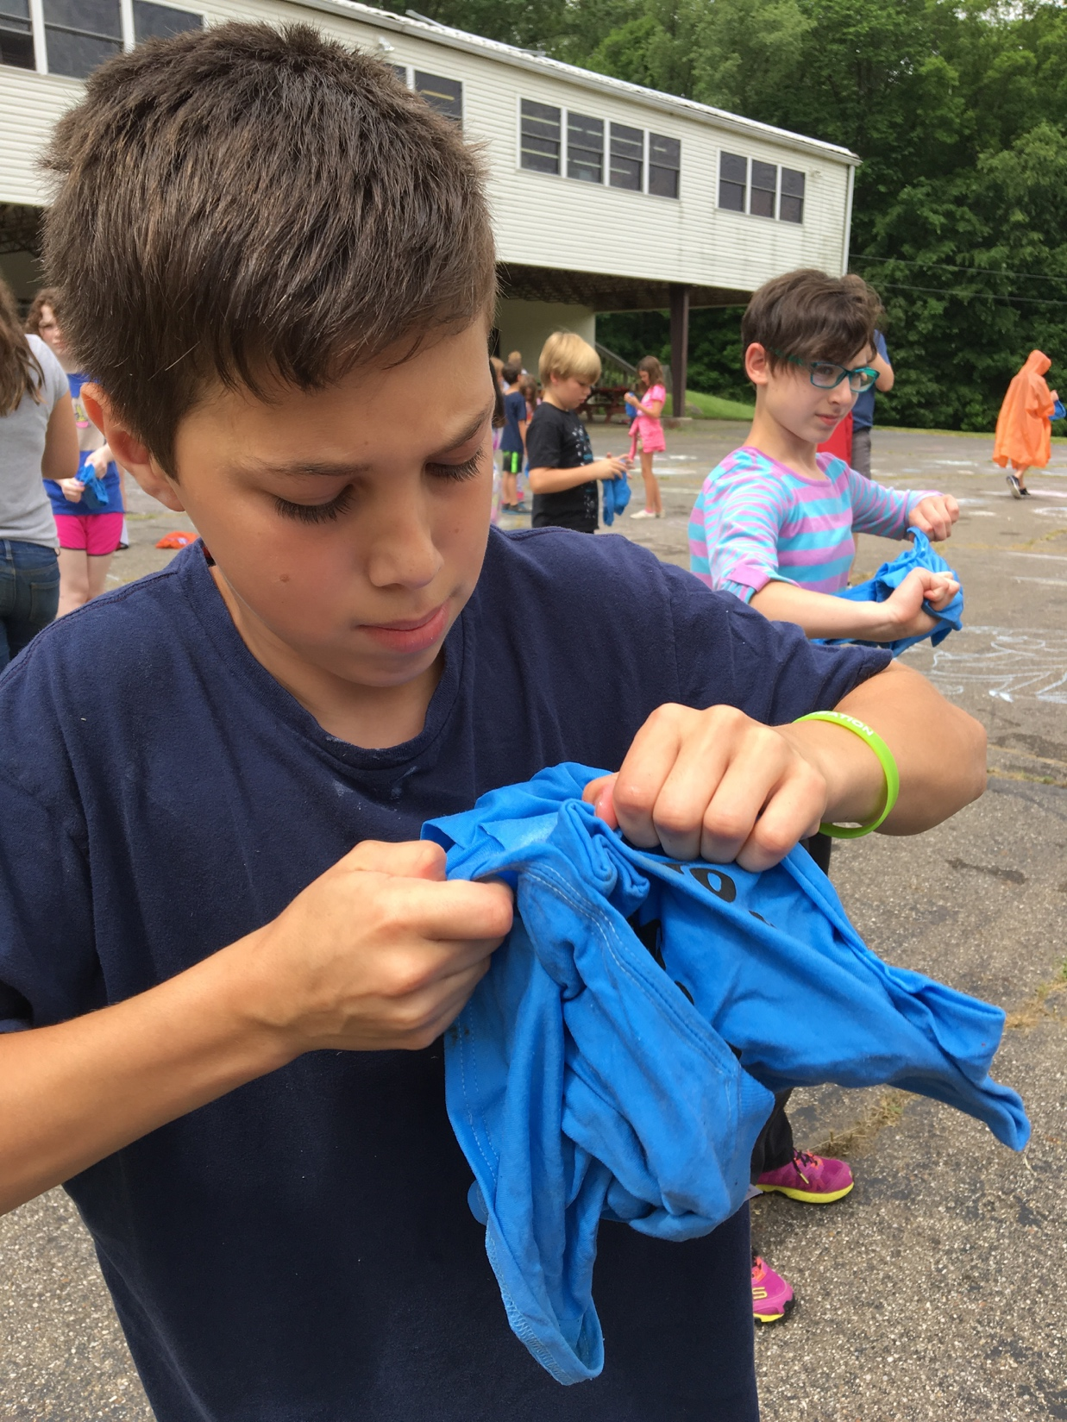
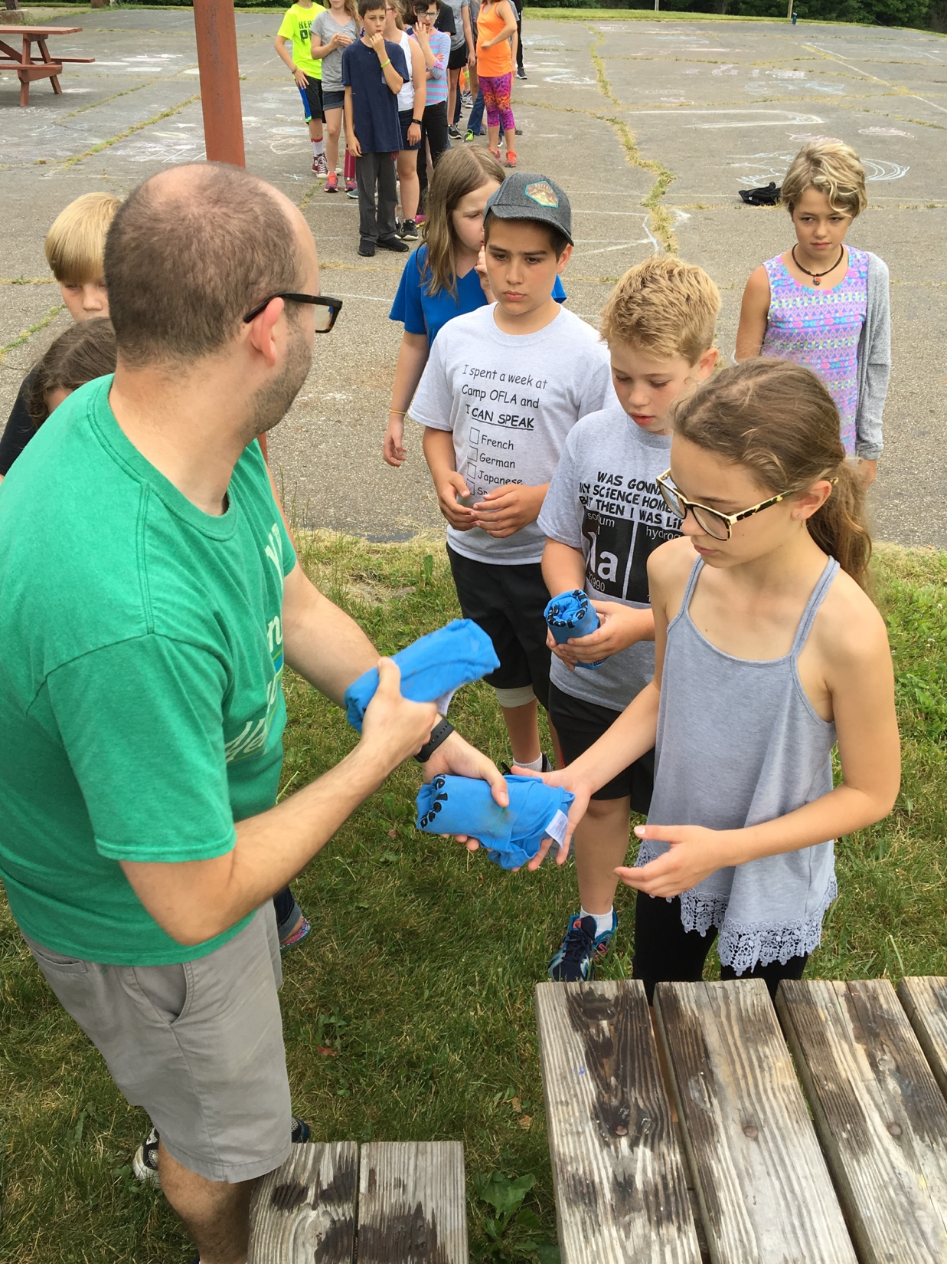
Activities: Frozen T-shirts

Slide 14
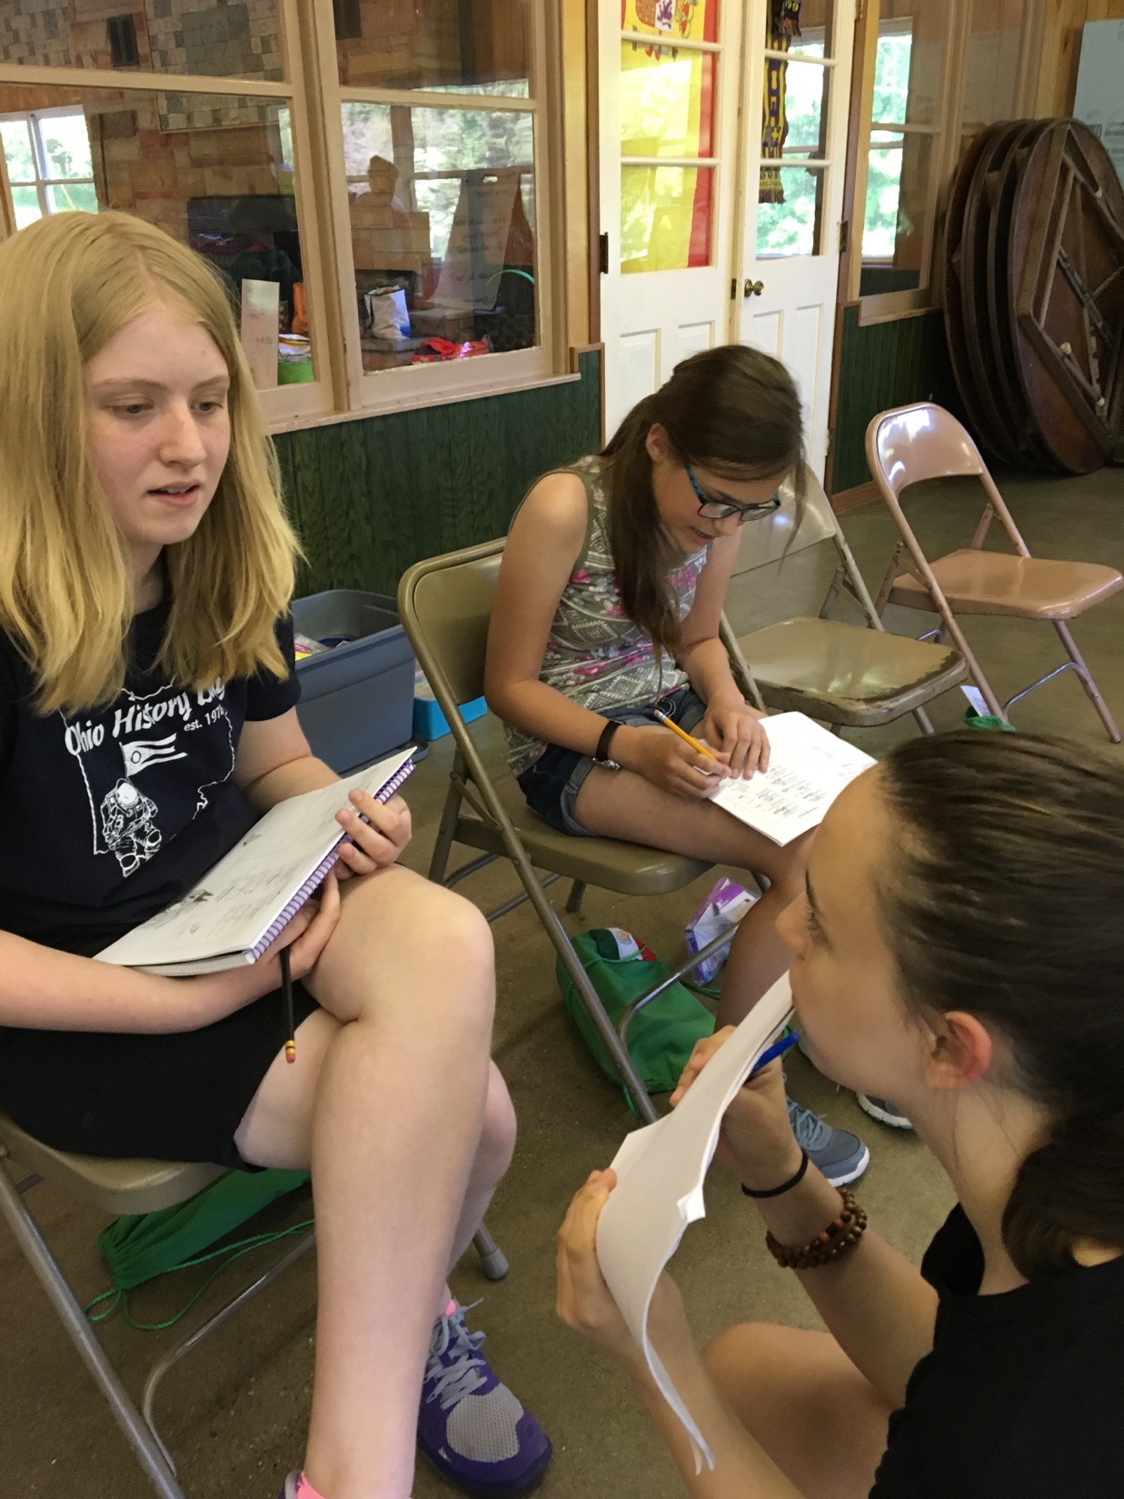
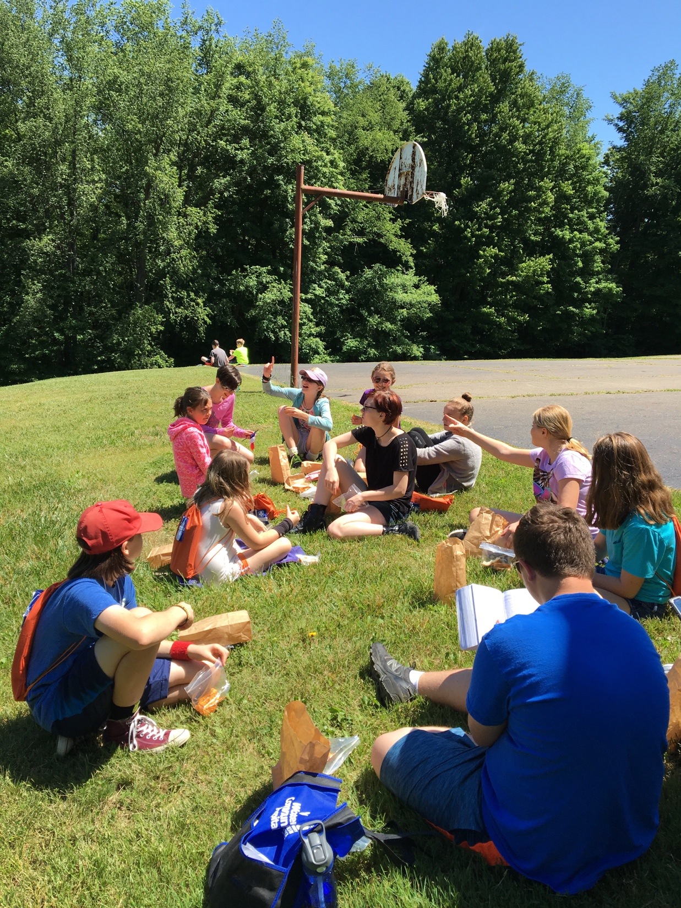
Language Practice

Slide 15
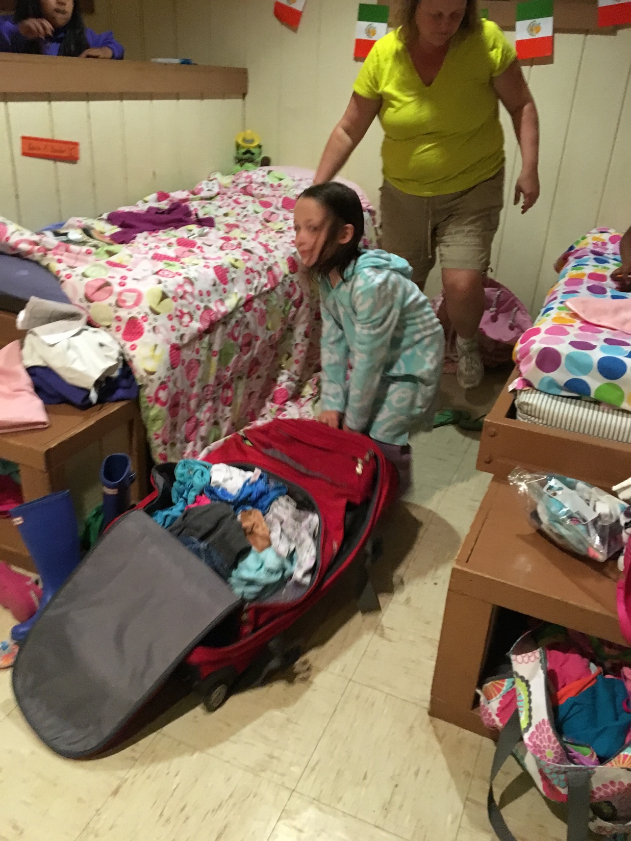
Chores

Slide 16
Storytelling Lessons
TPRS techniques
Our own
Modified folk tale
Themes
●A Day in the Life
● Postcards Home
● Camp Animals
● Pete the Cat
● Let’s Celebrate

Slide 17
Parents follow daily on Facebook
Like us! Follow us!
Camp OFLA

Slide 18
Camp OFLA 2021 June 6-12
Arabic, Chinese, Russian

Slide 19
Camp OFLA 2021
www.campofla.org
Join Us!

